Slide 1
The First Step to Creating Acceptable Figures:
Review the online “Instruction to Authors” of the journal to which you are submitting. You should find information about the journal figure’s column widths, font usage, and acceptable file types for submission.
Inserting Images into PowerPoint:
The resolution of your images should be at least 300 dpi at final size. The color mode of the TIFF/JPEG files that your are inserting should be either Grayscale or RGB (Red, Green, Blue) color space. CMYK (Cyan, Magenta, Yellow, Key/Black) color space is not accepted by PowerPoint.
Font Usage:
Helvetica, Arial, Times News Roman, and Symbol fonts are the preferred fonts by most journals. They reside on most computers and reproduce well. Courier, a monospace font, can be used for sequences. In general, 8 point text is the smallest accepted size for regular journal figure labeling. Superscripts and subscripts should be no smaller that 5 point.
Consistency:
Figures that maintain a common or unified look, such as font size and color choices, always present well. They show the reader that the message that you are conveying has been well thought through.
Line/Stroke Weight:
Always keep in mind the final size of your figures: Your line weights at final size should be no thinner than ½ point.
Contrast:
Make sure your reader can distinguish between different areas of you figures. This is very critical when creating black/white/gray figures.
File Types for Submission:
Most journals don’t accept native PowerPoint files. You will have to save your PPT files to either PDFs or TIFFs.
Take Time to Use the Alignment Tools:
This tool will help polish your figures’ appearance.
Use Colors Wisely:
Only use color when necessary. Use color to highlight or enhance. Too many colors can be distracting. The more complex your figure the more likely you will need color to convey your message. Please also keep in mind that some men are color blind, so contrast in value plays critical role.
A
Figure Label
Figure Label
SAMPLE
Figure Label
Figure Label
Figure Label
Figure Label
Figure Label
Figure Label
Figure Label
Figure Label
Figure Label
1
2
3
4
5
Additional helpful hints can be found on the next page.

Slide 2
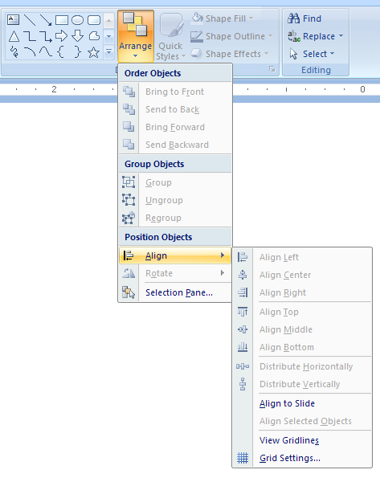
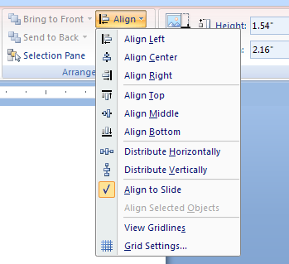



A
Alignment Tool
PowerPoint’s Alignment Tools can be accessed two ways.
A. Go to PowerPoint’s “Home” tab. Select “Arrange” to “Position Objects/Align”
or
B. Double click on your image to activate the “Format” tab. Select “Arrange” to “Position Objects/Align”
B
A
Crop Tool
Double click on your image to activate the “Format” tab. Select “Crop” (A) to activate the crop handles (B) around your image. Adjust your crop handles to hide the unwanted area (C).
B
Crop Handles
C
Hanging Indents: Aligning Serial Text
Here is a technique to visually clean up serial text that goes beyond a single line of text per bullet/ number/letter.
Click inside the text ruler to activate the desired tab set and position the tab where the text should align beyond the bullet/number/letter.
Drag the bottom half of the margin indicator over to align with the first tab set to position the hanging indent.
Tab Selector
Margin Indicator
Text Ruler
Tab Set
Hanging Indents
Hanging Indent aligned with Tab Set

